Slide 1
Modern Development Methodologies

Slide 2
What is Modern Development Methodologies?
Modern development methodologies are approaches and practices used by software development teams to manage projects, collaborate effectively, and deliver high-quality software products. These methodologies have evolved in response to changing technology, market demands, and organizational needs. They emphasize iterative development, continuous feedback, and adaptability to change. Some key modern development methodologies include:

Slide 3
Agile Methodology
Scrum
Kanban
DevOps
Lean Software Development
Scaled Agile Framework (SAFe)

Slide 4
Agile Methodology
Agile is an iterative and incremental approach to software development that emphasizes flexibility, customer collaboration, and responsiveness to change.
It prioritizes delivering working software in short iterations (sprints), frequent customer feedback, and continuous improvement.
Agile methodologies include Scrum, Kanban, Extreme Programming (XP), Lean Software Development, and others.

Slide 5
Scrum
Scrum is an Agile framework that organizes work into fixed-length iterations called sprints.
It defines roles (Product Owner, Scrum Master, Development Team), ceremonies (Sprint Planning, Daily Standups, Sprint Review, Sprint Retrospective), and artifacts (Product Backlog, Sprint Backlog, Increment) to facilitate collaboration and transparency.

Slide 6
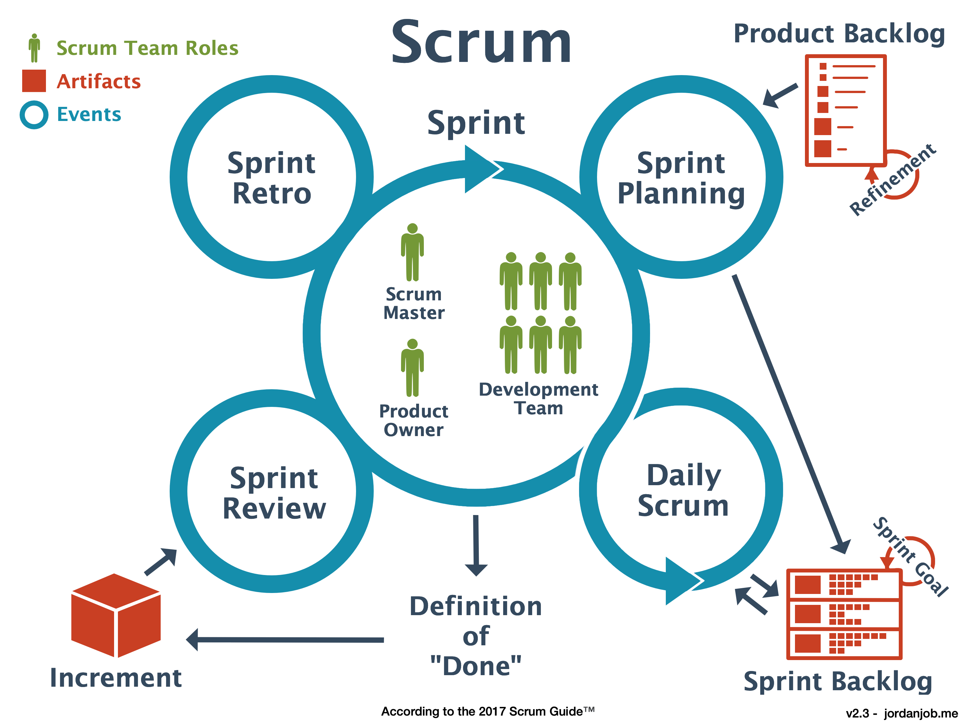

Slide 7
Kanban
Kanban is a visual management method that focuses on visualizing work, limiting work in progress (WIP), and optimizing workflow.
Work items are represented as cards on a Kanban board, and teams move them through columns representing different stages of the workflow.
Kanban promotes continuous delivery, flow efficiency, and continuous improvement.

Slide 8
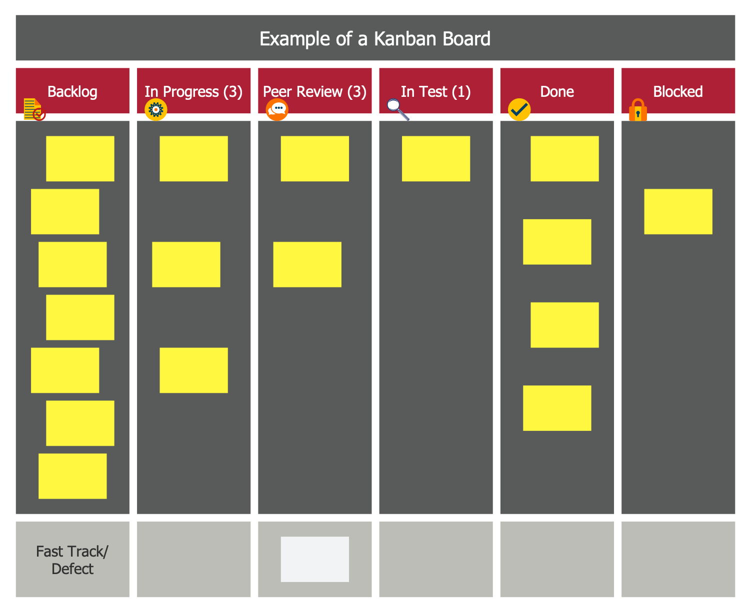

Slide 9
Extreme Programming (XP)
Extreme Programming (XP) is an Agile software development methodology that emphasizes flexibility, collaboration, and delivering high-quality software incrementally. It was created in the late 1990s by Kent Beck, Ward Cunningham, and others, with the goal of improving the software development process and addressing common challenges such as changing requirements, unclear specifications, and long development cycles

Slide 10
DevOps
DevOps is a cultural and organizational approach that promotes collaboration between development and operations teams to automate processes, accelerate delivery, and improve software quality.
It integrates practices such as continuous integration (CI), continuous delivery (CD), infrastructure as code (IaC), and automated testing to streamline software development and deployment.

Slide 11
Lean Software Development
Lean Software Development is based on lean manufacturing principles and focuses on maximizing customer value while minimizing waste.
It emphasizes delivering only what is necessary, eliminating bottlenecks, and continuously improving processes.
Lean practices include value stream mapping, reducing cycle time, and optimizing workflow.

Slide 12
Scaled Agile Framework (SAFe)
SAFe is a framework for scaling Agile practices to large organizations.
It provides guidance on coordinating work across multiple Agile teams, aligning with business objectives, and ensuring consistency and transparency at scale.
SAFe includes roles, ceremonies, and artifacts tailored for large-scale Agile development, such as Program Increment (PI) planning and Agile Release Trains (ARTs).

Slide 13
Test-Driven Development (TDD)
Behavior-Driven Development (BDD)
Feature-Driven Development (FDD)

Slide 14
What is Test Driven Development?
Test-Driven Development (TDD) is a software development approach in which developers write automated tests for their code before writing the actual implementation. The TDD process typically follows these steps:

Slide 15
1.Write a Test
Developers start by writing a test case that defines the desired behavior of a small piece of functionality.
Tests are written in a testing framework such as JUnit (for Java), NUnit (for .NET), or pytest (for Python).
The test should be small, focused, and cover one specific aspect of the code's behavior.

Slide 16
2.Run the Test (and Fail)
Next, developers run the test, expecting it to fail initially since the corresponding code has not been implemented yet.
This step ensures that the test is valid and that it correctly identifies missing functionality.

Slide 17
3. Write the Code
Developers implement the minimum amount of code necessary to make the test pass.
The focus is on writing the simplest code to fulfill the test requirements, without over-engineering or premature optimization.

Slide 18
4.Run the Test (and Pass)
Once the code has been implemented, developers rerun the test to verify that it now passes.
A passing test indicates that the code behaves as expected and satisfies the defined requirements.

Slide 19
5.Refactor (if needed)
After the test passes, developers may refactor the code to improve its design, readability, or performance.
Refactoring ensures that the code remains clean, maintainable, and adaptable to future changes.

Slide 20
6.Repeat
Developers repeat this cycle for each new piece of functionality or change to existing functionality.
Each test case drives the development process, incrementally building up the software's functionality while maintaining a suite of automated tests that validate its correctness.

Slide 21
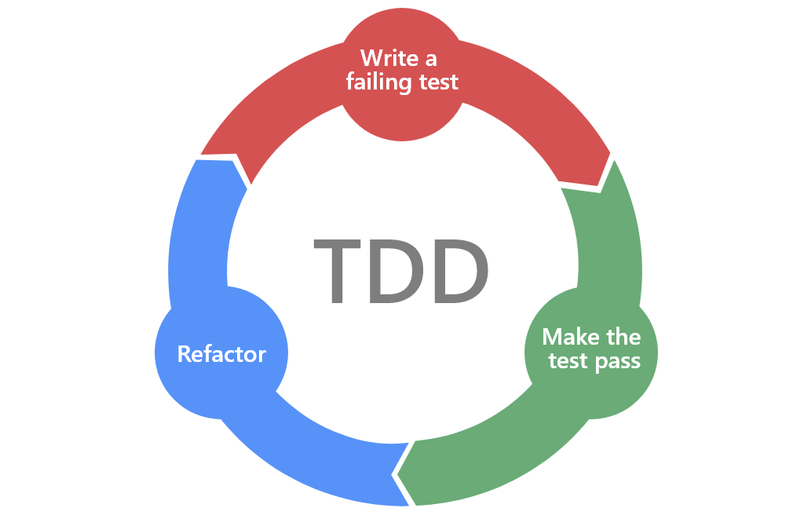

Slide 22
The key benefits of Test-Driven Development include
Improved Code Quality: TDD encourages developers to write clean, modular, and well-tested code that meets the specified requirements.
Faster Feedback: Automated tests provide immediate feedback on the correctness of code changes, allowing developers to detect and fix defects early in the development process.
Confidence in Refactoring: With a comprehensive suite of tests in place, developers can refactor code confidently, knowing that any regressions will be caught by the tests.
Better Design: TDD often leads to better software design, as it encourages developers to focus on writing testable, decoupled code with clear interfaces.

Slide 23
Conclusion
Develop tests for each small functionality before writing the code.
Ensures the software is built with testing in mind, leading to fewer bugs.
Encourages simple designs and inspires confidence in software reliability.
Test-Driven Development is a disciplined approach to software development that promotes quality, reliability, and maintainability by prioritizing testing throughout the development lifecycle.

Slide 24
Business-Driven Development (BDD)
Business-Driven Development (BDD) is a software development methodology that focuses on aligning software development activities with the strategic goals and needs of the business. Unlike traditional development approaches that may prioritize technical requirements or features, BDD puts a strong emphasis on delivering business value and meeting the needs of stakeholders. Here's an overview of Business-Driven Development:

Slide 25
Focus on Business Objectives:
BDD starts with a clear understanding of the business objectives, goals, and priorities. Development efforts are guided by these objectives, ensuring that software solutions directly contribute to achieving business success.
Collaboration with Business Stakeholders:
BDD emphasizes collaboration between development teams and business stakeholders, including executives, product owners, managers, and subject matter experts.
Business stakeholders actively participate in the development process, providing input, feedback, and guidance to ensure that the software meets their needs and aligns with business strategies.

Slide 26
3.User-Centric Design:
BDD places a strong emphasis on understanding the needs and expectations of end-users.
Development teams work closely with business stakeholders to gather user requirements, identify user personas, and prioritize features based on user feedback and usability testing.
4.Specification by Example:
BDD encourages the use of "specification by example," where requirements are expressed in the form of concrete examples or scenarios that illustrate desired system behavior.
Examples are written in a structured, business-readable format using tools like Gherkin syntax, making them accessible to both technical and non-technical stakeholders.

Slide 27
5.Test-Driven Development (TDD):
BDD often incorporates Test-Driven Development (TDD) practices, where tests are written before the code is implemented.
Tests are written from a business perspective, focusing on validating that the software meets the specified requirements and delivers the expected business outcomes.
6.Continuous Feedback and Iterative Improvement:
BDD promotes continuous feedback loops between development teams and business stakeholders.
Feedback from stakeholders, user acceptance testing (UAT), and real-world usage is used to drive iterative improvements and refinements to the software.

Slide 28
7.Measurement of Business Impact:
BDD emphasizes measuring and quantifying the business impact of software development efforts.
Key performance indicators (KPIs) and metrics are used to evaluate the effectiveness of software solutions in achieving business objectives and delivering value to stakeholders.

Slide 29
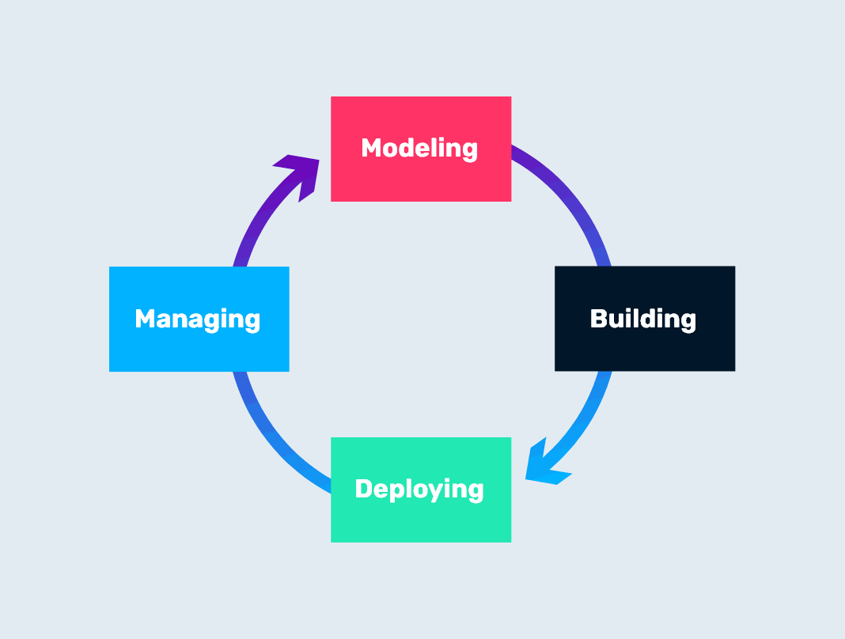
BDD

Slide 30
Conclusion
Focuses on the behavior of an application for the end-user.
Facilitates communication between developers, QA teams, and non-technical stakeholders.
Helps ensure the development process aligns with business goals.
By adopting Business-Driven Development practices, organizations can ensure that software development efforts are closely aligned with business needs, resulting in solutions that are more relevant, valuable, and successful in driving business growth and innovation.

Slide 31
Feature-Driven Development (FDD)
Feature-Driven Development (FDD) is an iterative and incremental software development methodology that focuses on delivering features incrementally while emphasizing collaboration, domain modeling, and a disciplined approach to development. Developed by Jeff De Luca and Peter Coad in the mid-1990s, FDD is particularly suited for large, complex projects with diverse teams. Here's an overview of Feature-Driven Development:

Slide 32
Domain-Driven Design:
FDD starts with modeling the problem domain to understand the business requirements and identify key features of the system.
Domain experts and stakeholders collaborate with development teams to create a domain model that represents the core concepts, relationships, and processes of the business domain.
Feature List Creation:
Once the domain model is established, the development team identifies and prioritizes features based on business value, complexity, and dependencies.
Features are decomposed into smaller, manageable tasks or user stories, each representing a specific piece of functionality that can be implemented and tested independently.

Slide 33
3.Feature Teams:
FDD organizes development teams around features rather than components or layers.
Each feature team is responsible for delivering a specific set of features, including analysis, design, implementation, and testing.
4.Iterative and Incremental Development:
FDD follows an iterative and incremental approach to development, with each iteration focused on delivering one or more features.
Iterations typically last 2-4 weeks and result in a working, tested increment of functionality that can be demonstrated to stakeholders.

Slide 34
5.Feature-Driven Process:
FDD defines a set of five processes to manage the development lifecycle: Domain Object Modeling, Development by Feature, Component/Class Ownership, Feature Set Integration, and Regular Builds.
These processes provide guidance on how to analyze, design, implement, and integrate features effectively while maintaining quality and consistency.
6.Regular Inspections:
FDD emphasizes regular inspections and reviews to ensure that development efforts are aligned with project goals and quality standards.
Inspections may include code reviews, design reviews, walkthroughs, and demonstrations of completed features to stakeholders.

Slide 35
7.Emphasis on Quality:
FDD places a strong emphasis on delivering high-quality software that meets user requirements and conforms to coding standards and best practices.
Continuous integration, automated testing, and regular inspections help maintain code quality and prevent defects.

Slide 36
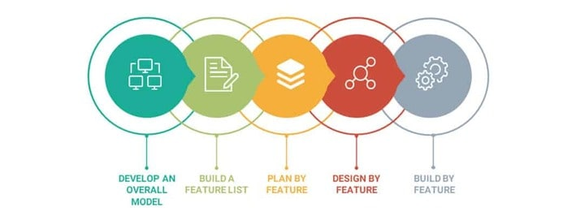

Slide 37
Overall, Feature-Driven Development is a pragmatic, disciplined approach to software development that focuses on delivering features incrementally, managing complexity, and ensuring alignment with business objectives. It promotes collaboration, domain modeling, and iterative delivery, making it well-suited for large, complex projects with evolving requirements.
Emphasizes delivering tangible, working software repeatedly in a timely manner.
Focuses on building and designing features.
Encourages status reporting at all levels, ensuring clarity and accountability.

